Slide 1
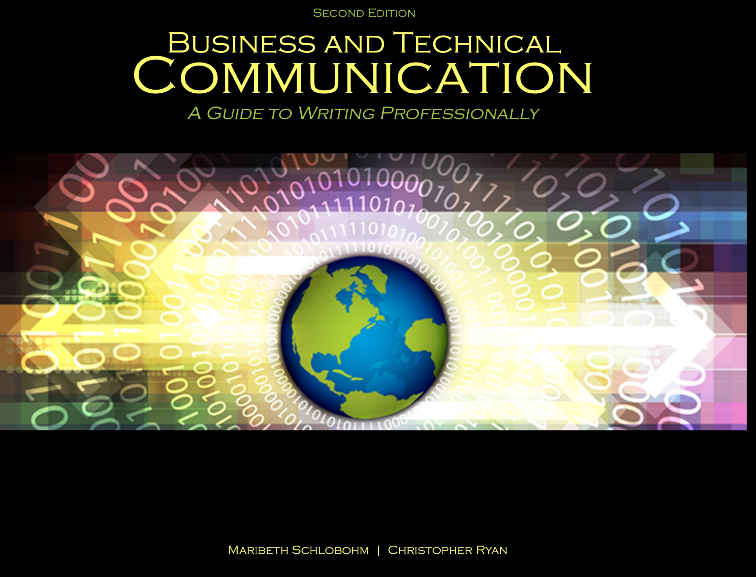
Chapter 5: Telephone, Text, Email, Letters, and Memos

Slide 2

Communication May Be:
Communication Type | Informal | Formal
Internal | Internal/Informal: Daily reports Weekly reports Co-worker email Water cooler/grapevine | Internal/Formal: Annual budget Project proposals Project reports Promotion Announcements Company newsletter
External | External/Informal: Employee Social Networking Company Social Networking | External/Formal: Annual Reports Product Announcements Letters/Memos/Email Copyright/Patent Applications Conference White Papers

Slide 3
Communication Platforms
Platform | Brevity | Immediacy | Clarity | Person-to-Person Communication | Group Communication
Telephone | ✔ | ✔ | ✔ | ✔ | ✔
Text | ✔ | ✔ |  | ✔ | ✔
Email | ✔ |  | ✔ | ✔ | ✔
Memo | ✔ |  | ✔ |  | ✔
Report | may be |  | ✔ |  | ✔
Proposal | may be |  | ✔ |  | ✔
White Paper | ✔ | ✔ |  |  | ✔
Technical Definitions |  |  | ✔ |  | ✔
Technical Glossaries |  |  | ✔ |  | ✔
Instructions & Specifications | ✔ |  | ✔ |  | ✔
Policies |  |  | ✔ |  | ✔
Manuals |  |  | ✔ |  | ✔

Slide 4
Text Characteristics
Brevity
Immediacy
Person-to-person
Person-to-group
Limited to 140-160 characters
Informal text “language” – LOL, ROFL, BTW

Slide 5
Email Characteristics
Brevity
Clarity
Person-to-person
Person-to-group
Up to 72 hour return email etiquette
Document attachments

Slide 6
Email Comparisons
Email compared to letters:
Informal, shortened form of communication
Suitable for:
Keeping a team on task
Transmitting documents
Email compared to memos:
Built in fields for date, to, from, subject
Flexibility for arranging by fields and importance

Slide 7
Email Problems
Reply vs. reply all
Overuse of high priority
Response time up to 72 hours
Long email strings
Empty subject lines
Flaming with ALL CAPS
Spam
Communication unclear due to no verbal cues

Slide 8
Letter Types
Good news – delivers good or neutral news
Includes: transmittal, cover, acceptance, hiring, recommendation, thank you, and scope of work
Bad news – delivers bad news
Includes: back order, delay shipment, out of stock, discontinued, job rejection, firing, and lay off
May include a buffer to bad news

Slide 9
Letter Formats & Elements
Formats: block and modified block
Elements:
Letterhead
Date
Addressee
Subject
Salutation
Three paragraphs
Signature block
Attachment

Slide 10
Letters: Three paragraphs
1st paragraph: Introduction. Clearly and concisely states why the letter is being written
2nd paragraph: Body. Expands reason for writing with details
3rd paragraph: Conclusion. Contains contact information (phone, email, website) and hours of availability, including time zone

Slide 11
Memo Elements
Title – “Memorandum” or “Memo”
Date
To
From
Subject (SUBJ) or Regarding (RE)

Slide 12
Memo Uses
Informal reports and proposals
Company policies and procedures
Statement of work (SOW)
Memorandum
DATE: April 1, 2015
TO: Communication students FROM: Professor Smith SUBJ: Communication Basics

Slide 13
References
Schlobohm, Maribeth and Christopher Ryan. Business and Technical Communication: A Guide to Writing Professionally, 2nd Ed., Dubuque, IA: Kendall-Hunt, 2014. Print.

Slide 14
Contact Information
Kendall-Hunt Publishing Company
4050 Westmark Drive
Dubuque, IA 52004-1840
http://www.kendallhunt.com
Toll Free: 800-228-0810

